Slide 1

AI & QUALITATIVE ANALYSIS: A HANDS-ON TRAINING
Virtual Training organised by the Postgraduate College, Lead City University, held at the Conference Centre, Lead City University, Ibadan, Oyo State, on Thursday, 30 April 2026.
Raimi, L. PhD, LL.M, FIIP, FIMC, FCEnt Assistant Professor of Entrepreneurship & Program Leader
School of Business and Economics Universiti Brunei Darussalam, Darussalam

Slide 2

Presentation Outline
Learning Outcomes
Introduction
What is Data Analysis?
What is Qualitative Data Analysis?
Can ChatGPT Conduct Data Qualitative Analysis?
Validity of AI for Qualitative Research
AI-Supported Qualitative Data Analysis
Adherence to the CREP Strategies
Conducting Qualitative Data Analysis with ChatGPT with a real-world dataset (Practical Session 2)
Questions and Answers

Slide 3

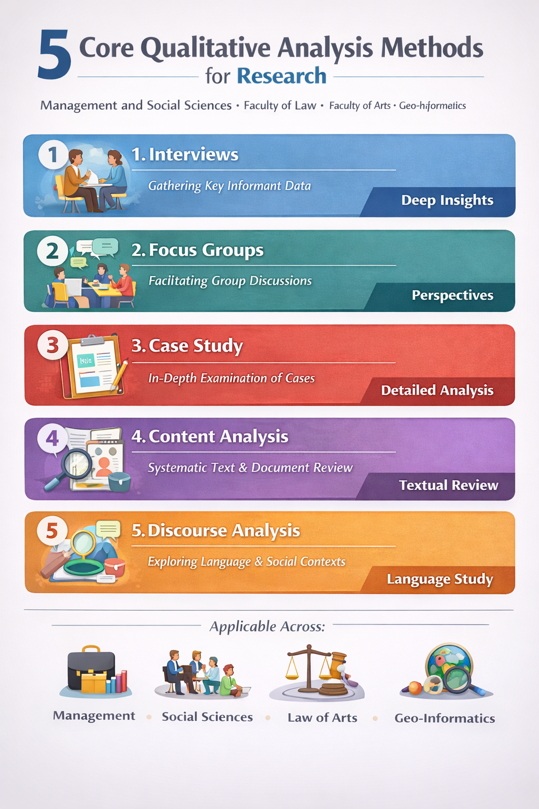

Slide 4
Learning Outcomes
At the end of the training, the postgraduate fellows/students should be able to:
Understand how to use premium AI-enabled ChatGPT to enhance qualitative data analysis in their fields.
Apply hands-on ChatGPT-assisted techniques for analysing, interpreting, and presenting qualitative data, including content analysis, thematic analysis, document analysis, systematic literature review and traditional reviews.
Enhance academic and research performance as postgraduate researchers by leveraging AI for efficient data analysis, critical thinking, and scholarly writing.

Slide 5
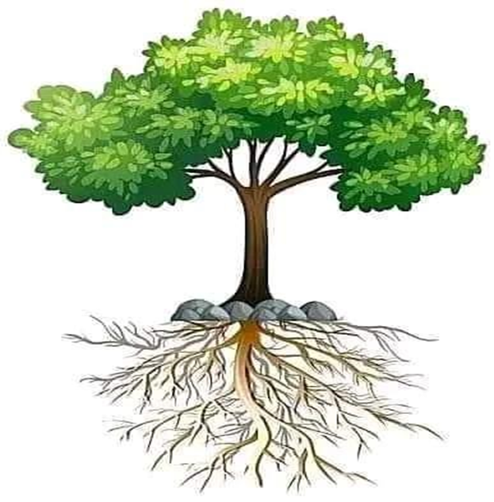
Introduction
The rapid advancement of AI has created unhindered access to analytical tools and cost-effective data analysis, enabling educators and students to enhance their teaching methodologies.
“Knowledge without application is simply knowledge. Applying the knowledge to one’s life is wisdom — and that is the ultimate virtue” ― Kasi Kaye Iliopoulos

Slide 6
What is Data Analysis?
Data analysis is the process of collecting, organizing, interpreting, and presenting data to uncover patterns, draw conclusions, and support decision-making. It involves using statistical, logical, and analytical techniques to understand what the data reveals about a phenomenon or research question.
Data analysis is one of the three core responsibilities of an academic lecturer, alongside teaching and community service.
It plays a critical role in fulfilling the maxim 'Publish or Perish' or, more recently, 'Be Visible or Vanish,' by enabling the production of impactful, data-driven research."

Slide 7
What is Qualitative Data Analysis?
Qualitative data analysis is a systematic, iterative, and interpretive process of organising, coding, categorising, and examining textual or visual data to identify patterns, themes, and meanings, thereby generating insights that explain social phenomena within their context (Creswell, 2014; Miles, Huberman, & Saldaña, 2014; Braun & Clarke, 2006).
It is characterised by smaller, purposively selected samples, which allow for deeper, richer, and more nuanced analysis of participants’ experiences and meanings. It focuses on depth rather than breadth, enhances contextual understanding, and supports interpretive insight (John W. Creswell, 2014; Greg Guest et al., 2006; Matthew B. Miles et al., 2014).

Slide 8
Can ChatGPT Conduct Data Qualitative Analysis?
The AI ChatGPT is designed to assist with data analysis, with human guidance and specification of the types of qualitative analysis. Specifically, ChatGPT can be valuable for the following qualitative analysis:
Interview Transcript development
Assist in qualitative data analysis (e.g., coding themes from interview transcripts).
Thematic analysis
Content analysis
Focus Group analysis
Systematic literature review (SLR)
Discourse Analysis
Summarise and explain findings in plain language for the document review
NB: You need the premium version of ChatGPT 4.0 to run reliable data analysis.

Slide 9
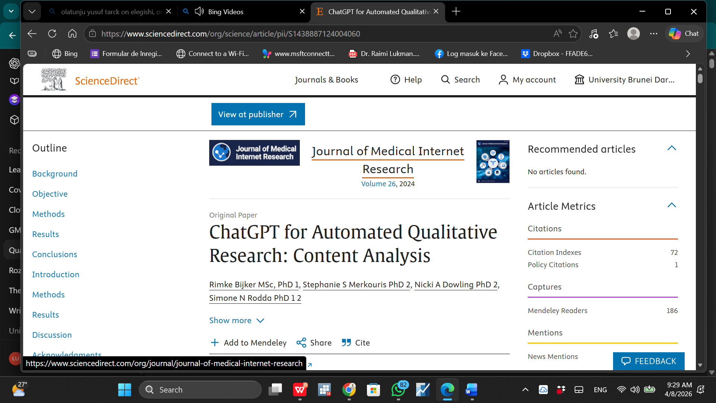
Validity of AI for Qualitative Research
High Efficiency and Speed: ChatGPT can rapidly analyse large volumes of qualitative text (e.g., interviews, open-ended responses), significantly reducing time compared to manual coding.
Reasonable Accuracy in Thematic Identification: It is capable of identifying themes, patterns, and categories that are broadly consistent with human qualitative researchers.
Consistency in Coding: Unlike human coders who may vary, ChatGPT provides more consistent outputs across similar datasets.
Limitations in Depth and Contextual Understanding: The model may miss nuanced meanings, cultural context, or implicit interpretations that experienced human researchers can detect.
Dependence on Prompt Design: The quality of results heavily depends on how well the prompts are structured—poor prompts lead to weaker analysis.
Best Used as a Support Tool (Not Replacement): ChatGPT is most effective as an assistive tool, enhancing productivity, but should not fully replace human judgment, especially in high-stakes academic research (Bijker, Merkouris, Dowling & Rodda, 2024

Slide 10

AI-Supported Qualitative Data Analysis
Thematic Analysis
Identifies, analyzes, and reports patterns (themes) within the data.
Involves coding, categorization, and theme development.
Content Analysis
Systematically categorises verbal or textual data.
Involves counting recurring words, phrases, or concepts.
Can be qualitative (interpreting meaning) or quantitative (frequency analysis).
Narrative Analysis
Examines the stories and experiences shared by participants.
Focuses on how individuals construct their life narratives.
Used in psychology, sociology, and media studies.
Discourse Analysis
Studies language use, social context, and communication patterns.
Analyzes power dynamics, ideology, and identity in interviews.

Slide 11
AI-Supported Qualitative Data Analysis 2
Document Analysis
Examination and interpretation of documents such as reports, policies, articles, records, and archives.
Involves coding, categorising, and interpreting textual or visual data to identify patterns, meanings, and insights.
Systematic Literature Review (SLR)
A structured, transparent, and replicable process of identifying, evaluating, and synthesising existing research on a specific topic.
Follows defined protocols (e.g., PRISMA guidelines)
Focus Group Analysis
Analyses data from group discussions (usually 5–10 participants) around a specific topic.
Focuses on shared views, interactions, and group dynamics
Identifies themes, agreements, disagreements, and dominant opinions
responses.

Slide 12

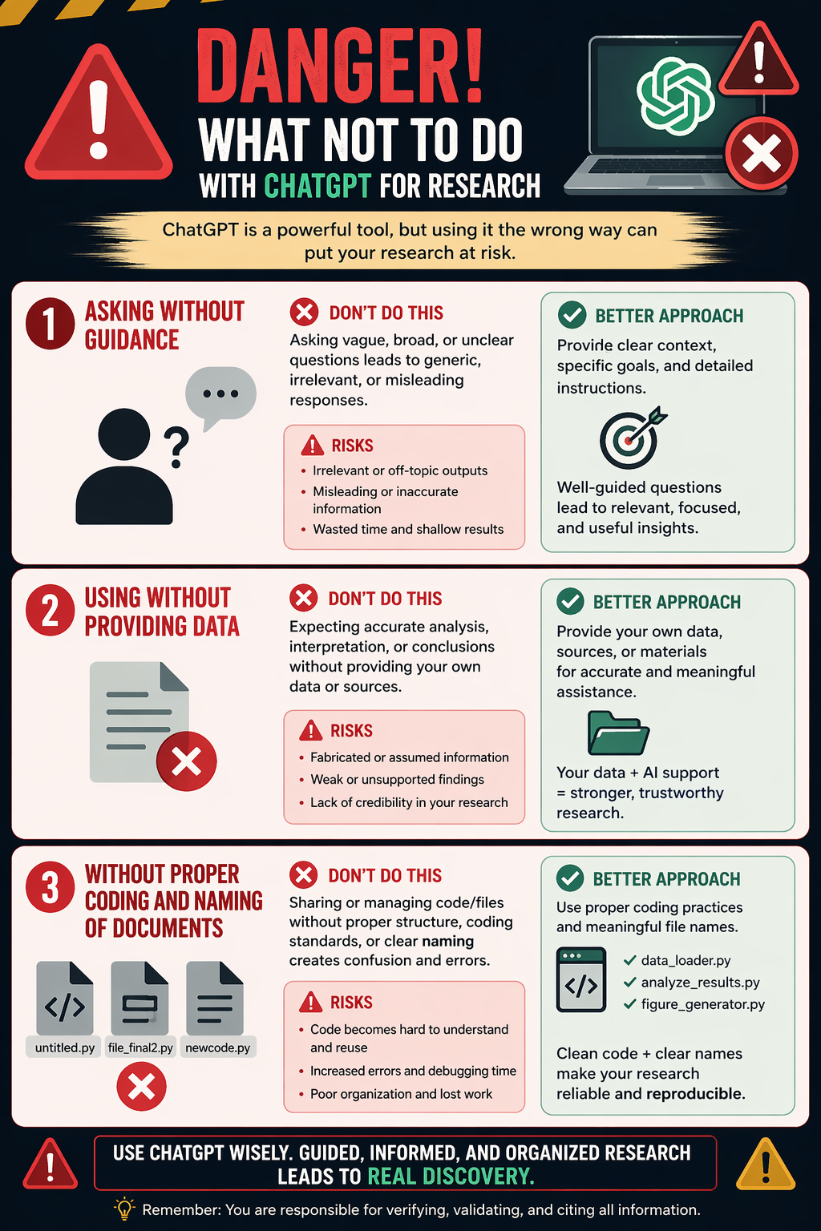

Slide 13
Adherence to the CREP Strategies
Over time, as an AI user, I have developed the CREP Strategy to guide effective use of ChatGPT while avoiding plagiarism and high similarity scores.
If left unregulated, ChatGPT could influence creative writing and compromise originality. Therefore, the CREP Strategy provides a set of principles that researchers should follow to ensure their work aligns with academic integrity and scholarly standards.
The CREP Framework
C – Use ChatGPT Creatively: Leverage AI to generate ideas, explore perspectives, and enhance innovation without copying outputs verbatim.
R – Use ChatGPT Responsibly: Verify, refine, and contextualise AI-generated content to ensure accuracy and relevance.
E – Use ChatGPT Ethically: Avoid plagiarism, acknowledge AI assistance where necessary, and uphold academic honesty.
P – Use ChatGPT Professionally: Apply AI in a manner consistent with scholarly writing standards, critical thinking, and originality.

Slide 14

Part 3
Conducting Qualitative Data Analysis with ChatGPT with a real-world dataset (Practical Session 2)
Thematic analysis
Content analysis
Document analysis
Systematic literature review (SLR)
Traditional literature review

Slide 15
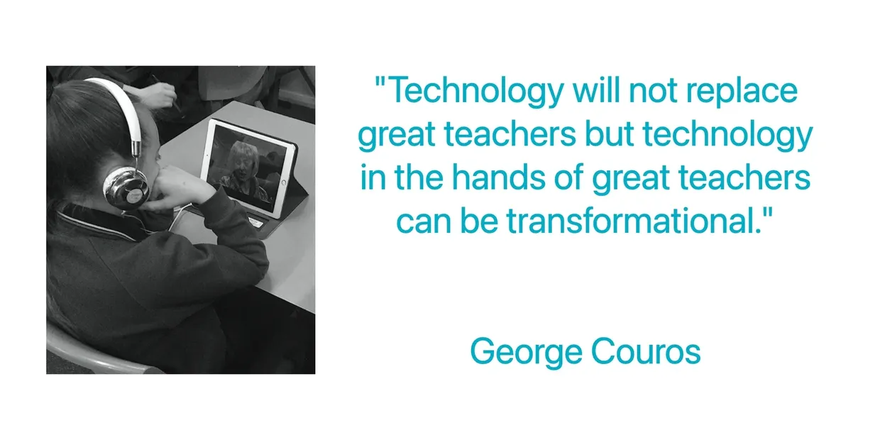
Conclusion

Slide 16



