Slide 1

Thesis Writing
Afolakemi O Oredein

Slide 2
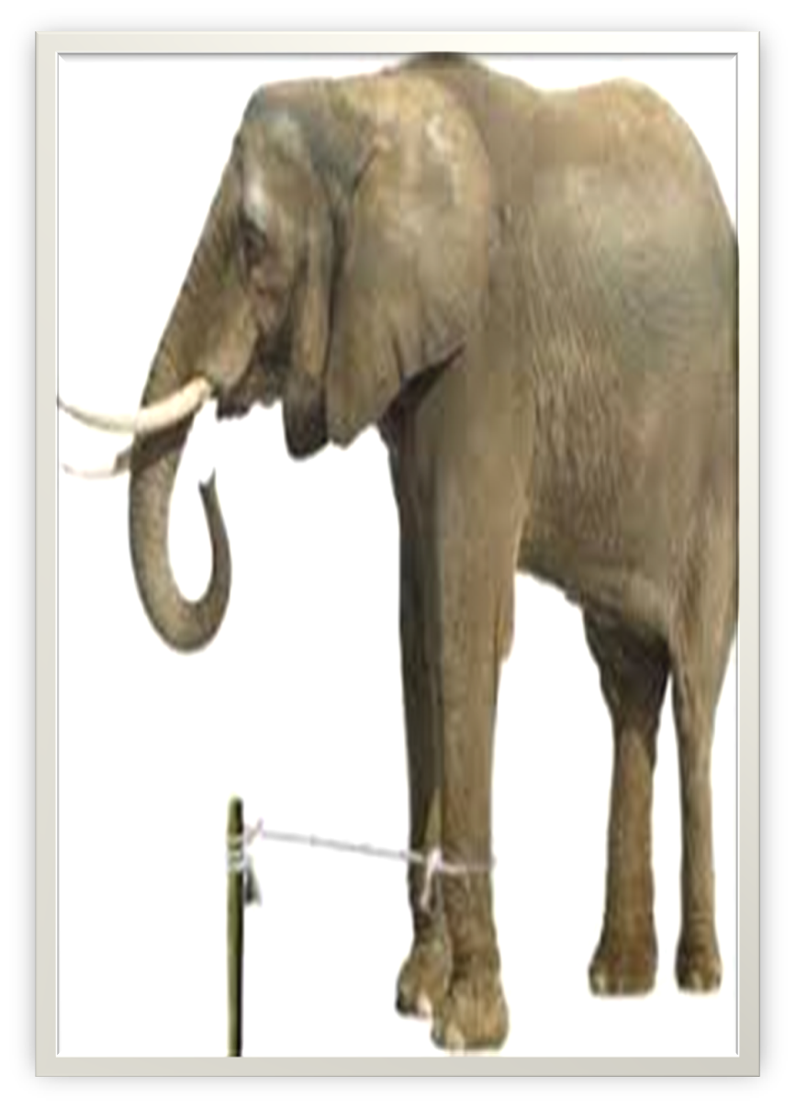
Elephant and the Stake

Slide 3
Outline
LCU Style of Writing
The Five Ws & H
Introduction
Conclusion

Slide 4
What is Research?
Non-empirical
Empirical

Slide 5
Cont’d
Non-empirical Research
- Fundamental
- Basic
- Theoretical
Empirical Research
- Applied
- Action

Slide 6
Attributes of a Research Topic
Length of your research topic
Research topic is NOT a statement nor sentence
Title should be precise, meaningful and unambiguous
It should also be simple enough for your readers to understand
Avoid abbreviation(s)
It should be well-defined

Slide 7

Research Writing
Is like writing a story

Slide 8
The Five Ws & H
What?
Why?
Where?
Who?
When?
How?

Slide 9

What?
Identifying the problem
Materials to be used

Slide 10

Why?
Purpose

Slide 11

When?
Duration

Slide 12

Where?

Slide 13
Who?
Respondents/Material to be used/
Beneficiary

Slide 14
How?
Methodology
Analysis of Results
Presentation of Results
Presentation of the whole work

Slide 15
LCU Style of Writing
Times New Roman of Font 12, Double Line Spacing except the Abstract
All headings and Sub-headings should be Initial Caps
The title page should be in four parts and each part should be single line. The year will be below the page. Title page should NOT be numbered and should be printed separately
Title of the Thesis
Name & Matric Number
The department/faculty/institution where it will be submitted to
The degree to be obtained
The numbering/paging is bottom and at the middle
The preliminary pages should be numbered in Roman Numeral

Slide 16
Title Page (A Dummy)
Lettuce and Leguminous Mixed Planting as Catalyst of Crop Productivity
Afolakemi O. Oredein LCU/PG/00001
Being an MSc Thesis Submitted to the Department of Biological Science, Faculty of Applied Sciences, Lead City University, Ibadan, Oyo state, Nigeria
In Partial Fulfillment of the Requirements for the Award of Master Degree (MEd) in Crop Production
2026

Slide 17
Preliminary pages are the opening pages that must be well arranged.
The pages are numbered in Roman Numerals ( i, ii, iii, iv,…)
ii Certification Page
iii Dedication Page
iv Acknowledgement
v Abstract
vi Table of Contents
vii List of Tables
viii List of Figures
ix List of Acronyms

Slide 18
Certification Page (A Dummy)
This is to certify that Afolakemi O. Oredein with matriculation number LCU/PG/00001 carried out this research work titled “Lettuce and Leguminous Mixed Planting as Catalyst of Crop Productivity in Southwest Nigeria ” in the Department of Biological Science, Faculty of Applied Sciences, Lead City University, Ibadan, Oyo State, for the award of Master Degree/Doctor of Philosophy Degree (M.Ed/M.Sc/LLM/M.A) in Crop Production and that this has not been previously submitted.
--------------(Signature) 02-11-2026
Dr. Ayinke Bandele (Supervisor)
--------------(Signature) 02-11-2026
Prof. Feranmi Bamkefa
(Head of the Department)

Slide 19
Dedication Page (A Dummy)
This research work is dedicated to God Almighty/…. (A sentence)

Slide 20
Acknowledgement
It must be scholarly NOT journalistic or full of ‘prayer meeting’ language
It is not an opportunity for praise singing or boot licking
Remove all non-scholarly expressions
Flowery language should be avoided
Write the names correctly
First Paragraph: The Institution where the research work was conducted, libraries used both within and outside, and other places relevant to the data collection
Second Paragraph: The department starting with the supervisor, and ALL other lecturers (both within and outside your department) who have imparted a great measure of knowledge to you (Names should be arranged well; Professors, and others with their initials). Also, those have contributed to the research work.
Lastly, the sponsor, family (just wife, children/siblings) who are relevant (in one or two lines).
Conclude it with a caveat like this:
“Even though the above-mentioned institutions and persons have assisted in the process of this research work, I alone stand responsible for the errors, if any, found in the work”

Slide 21
Abstract
It is the summary of the research work contents
To be in a paragraph
It is written after the research work MUST have been completed
It should NOT be more than 300 words for Master and 500 words for PhD.
Student should submit the e-copy of the final abstract to pgschoolabstract@lcu.edu.ng and to the Head of the Department
Things to be included in an abstract:
1. The overall purpose of the study and Objectives (A sentence)
2. The Gap filled and theory used (Two sentences)
3. The Methodology Used (research design, population, sample and sampling techniques, instrument for data collected and analysis) (Four sentences)
4. Key results (stating values if it is empirical research work) (Two sentences)
5. Major conclusion (A sentence)
6. Major recommendation (A sentence)

Slide 22
Table of Contents
It is the list that contains ALL the Front Matter, Main Content and Back Matter of the Thesis
Front Matter includes; Certification page, Dedication Page, Acknowledgement page, Abstract page and Table of Contents
Main Content includes; Chapters, Sub-headings and Endnotes at the end of each Chapter except chapter five
Back Matter includes; Bibliography (to be sub-divided into Books, Internet, Journals, Magazines, Newspapers, Periodicals, Proceedings, Unpublished Thesis, ….), Appendix(ces), Bio-data (CV format), and the University Compliance Form
It is the LAST thing to be completed so that it is 100% accurate (Content should align with the page)
It should be easy to read and accurately formatted
Headings and page numbers of all the front matter, main content and back matter should align with the body of the work

Slide 23
Line Margins
The Top – 1 Inch
Left Side – 1.25 Inches
Right Side 1 Inch
Below – 1 Inch

Slide 24
List of Tables (A Dummy)
Table Title Page
1.1 West Africa Examination Council Results, 2015-2020 9
2.1 Monitoring Cases 37
3.1 Teachers Population in Oyo State 48
4.1 Gender Distribution of Respondents 84

Slide 25
List of Figures (A Dummy)
Figure Title Page
1.1 Concept of Governance 11
2.1 The Campbell Performance Model 57
4.1 Bar Chart of Gender Distribution of Respondents 84

Slide 26
List of Acronyms (A Dummy)
Abbreviation Meaning
UNESCO United Nations Educational, Scientific & Cultural Organization
LCU Lead City University

Slide 27
Referencing Style
It is act of giving credit by citing the source of information used.
It helps to relate or link your work to previous work.
There are different styles of referencing.
1. Modern Language Association (MLA)
2. American Psychological Association (APA)
3. Chicago Referencing Style
4. Kate Turabian Referencing Style
5. Chicago Turabian Referencing Style
6. OSCOLA (Oxford Standard for Citation of Legal Authorities)
7. The Bluebook (A Uniform System of Citation)
8. AGLC (Australian Guide to Legal Citation)
9. Harvard referencing for law
10. McGill Guide (Canadian Guide to Uniform Legal Citation)
The one we use in Lead City University is Turabian Referencing Style and OSCOLA (for the Faculty of Law)
Turabian Referencing Style is named after the author who is from the University of Chicago, in person of Kate Turabian

Slide 28
How to Calculate Recency
Count and add up all the recent citations within five years to date
Count ALL citations
Recency = Total No of the Recent Citations X 100
Total No of ALL Citations
Year reviewed is NOT accepted please!

Slide 29
Chapter One
Introduction
1.1 Background to the Study
1.2 Statement of the Problem
1.3 Aim and Objectives of the Study (In some departments, Research Questions is 1.3 while Aim & Objectives is 1.4)
1.4 Research Question(s)
1.5 Hypothesis(es) (If necessary)
1.6 Significance of the Study/Justification of the Study (Engineering/Sciences)
1.7 Scope of the Study
1.8 Limitation of the Study (to be written at the end of the research work)
1.9 Operational Definition of Terms
Endnotes

Slide 30
A review of the area being researched
Current information surrounding the issue
Previous studies on the issue
Relevant history on the issue

Slide 31
Statement of the Problem
Set your aim
Identify the gap to fill
Identify the existing works
Show why it matters
Contextualize the problem

Slide 32
Chapter Two
Literature Review
2.1 Conceptual Review [pick the variables one by one] (As Applicable)
2.1.1 Lettuce
2.2.2 Leguminous
2.2 Theoretical Model/Framework (As Applicable)
[Related theory (ies)]
2.2.1
2.3 Review of Empirical Studies
[Previous research studies on lettuce and leguminous]
2.3.1
2.4 Conceptual Model
[The researcher’s conceptual model, showing the relationship between the independent and dependent variables]
2.5 Summary of the Reviewed Literature and the Gap
Endnotes

Slide 33
Chapter Three
Methodology
3.1 Research Design/Study Area (If Applicable)
3.2 Population of the Study (If Applicable)
3.3 Sample and Sampling Techniques (If Applicable)
/Research Materials and Experimental Procedures (If Applicable)
3.4 Description of the Research Instrument(s) (If Applicable)
3.5 Validity of Research Instrument (If you are using primary data)
3.6 Reliability of the Research Instrument (If you are using primary data)
3.7 Method of Data Collection
3.8 Method of Data Analysis
3.9 Ethical Consideration
Endnotes

Slide 34
Chapter Four
Results and Discussion of Findings
4.1 Demographic Data Analysis (If Applicable)
/Variables Measured
4.2 Presentation of Data
4.2.1 Research Question(s)
4.2.2 Hypothesis(es) (If any)
4.3 Discussion of Findings (To be written in paragraphs)

Slide 35
Presentation of Tables
Table 4.1: Demographic Data of the Respondents
Gender Frequency Percentage
Male 582 57.0
Female 439 43.0
Total 1021 100
Age Range
Less than 15Yrs 466 45.6
16 – 18 Yrs 504 49.4
Above 18 Yrs 51 5.0
Total 1021 100

Slide 36
Chapter Five
Conclusion
5.1 Summary of Findings (To be written in paragraphs and based on the findings)
5.2 Conclusion (To be written in paragraphs and based on the findings)
5.3 Recommendation(s) (To be numbered: i, ii, iii,/1,2,3,). Also, it should be based on the findings
5.4 Contribution to Knowledge
5.5 Suggested Area for Further Studies

Slide 37
Originality
Clarity
Systematic Structure
Objective and Evidence-based
Adheres to Ethical Standards

Slide 38


Slide 39


